Slide 1
Where’s Waldo: Matching People in Community Photo Collections
To appear in CVPR 2011
Rahul Garg, Deva Ramanan,
Steve Seitz, Noah Snavely

Slide 2
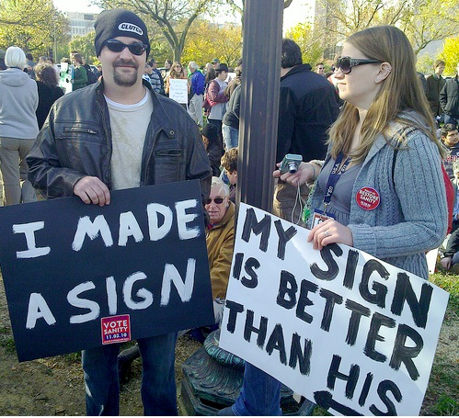
Notes:
Suppose, here’s a picture of couple of your friends taken at an event which was attended by many people.

Slide 3
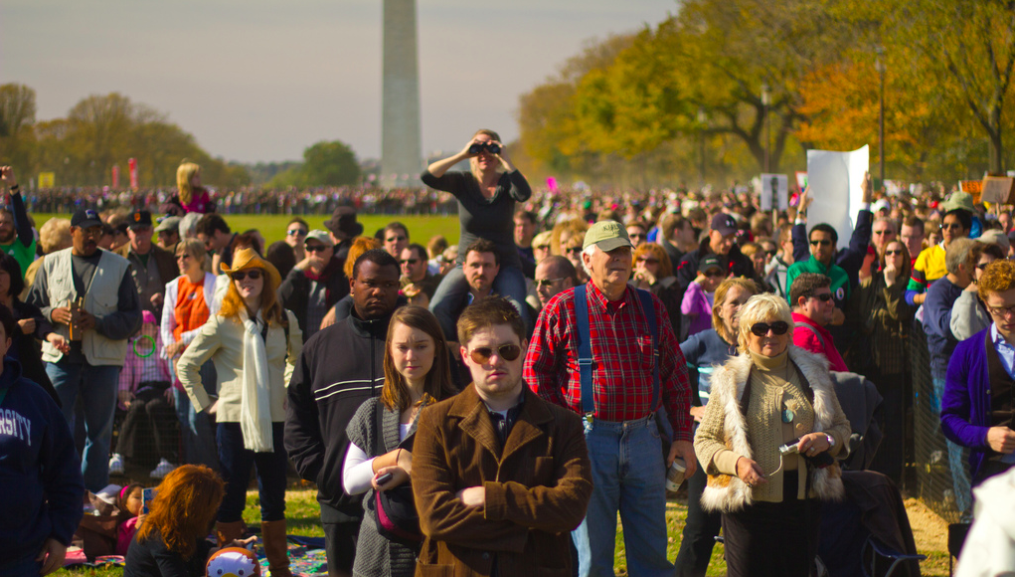
Can you find them in this photo?
Notes:
Here’s another picture of the same event taken by someone else, possible an unrelated person. Can you find them in this photo? One might claim, that there’s a very small chance of that. But what if there are thousands of photos of that event available?

Slide 4
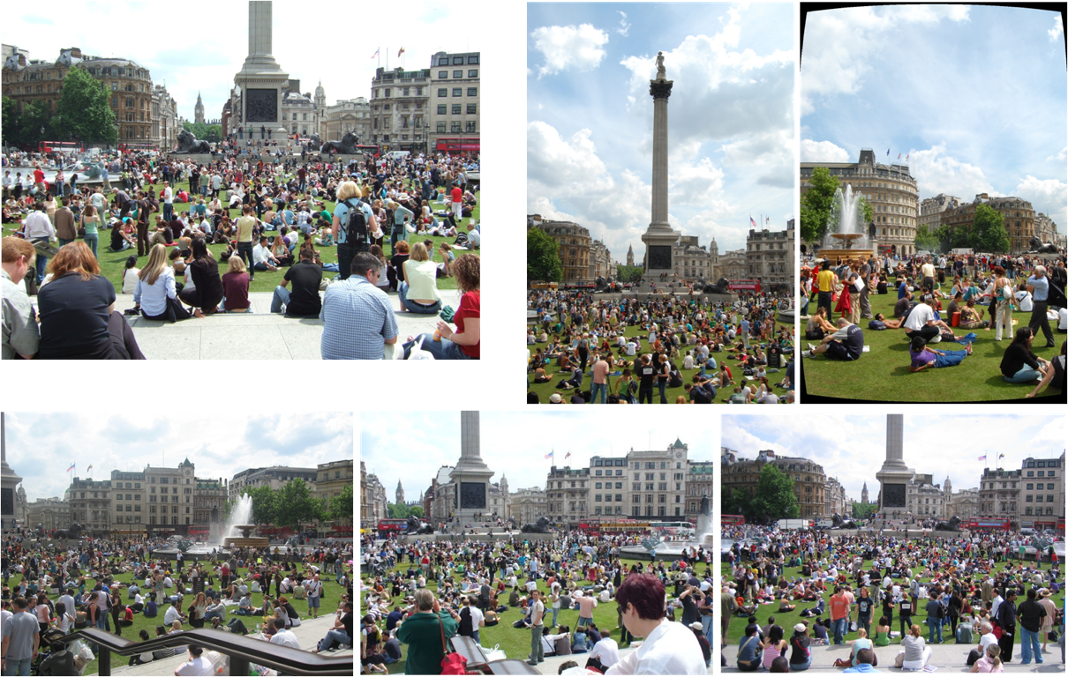
Notes:
To give another example, here are 6 different pictures of Trafalgar square, taken on the same day by 6 different people. Artificial grass was laid out on that particular day, many people came out and took pictures. These all are downloaded from Flickr.

Slide 5
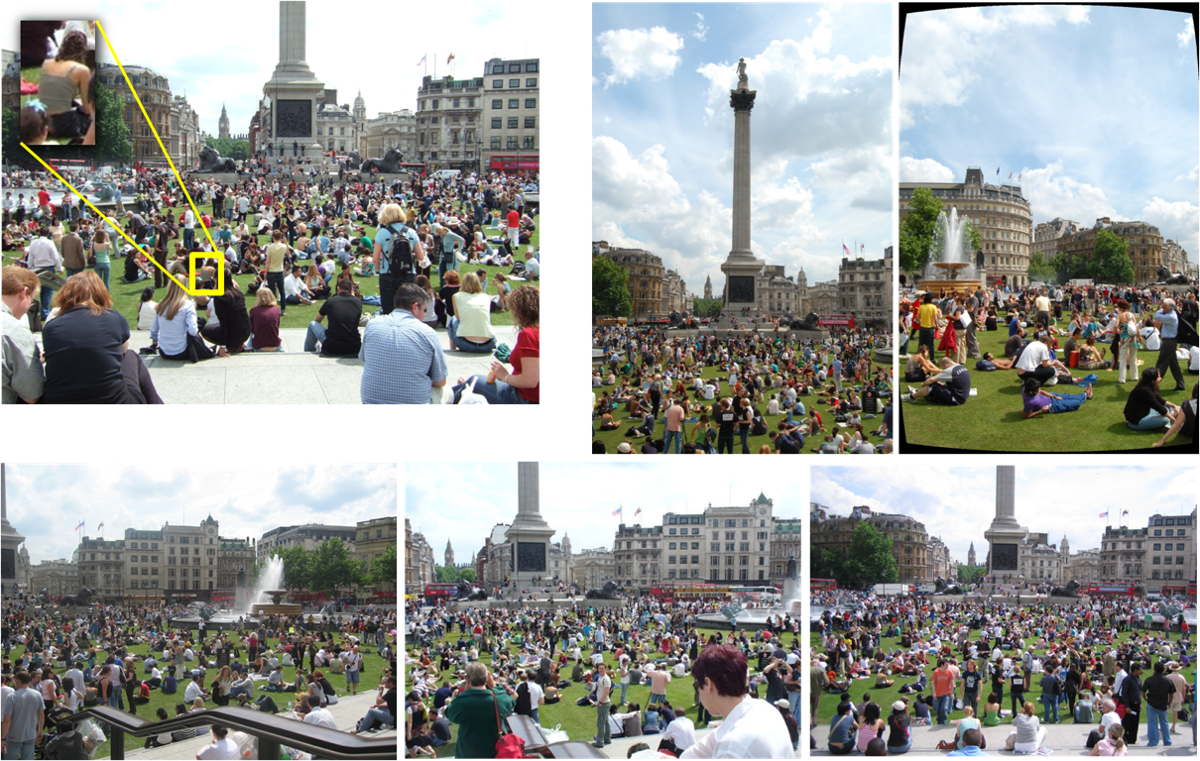
Where’s Waldo?
Notes:
Suppose I mark one particular girl in one of the pictures. Can you find all other photos of her?

Slide 6
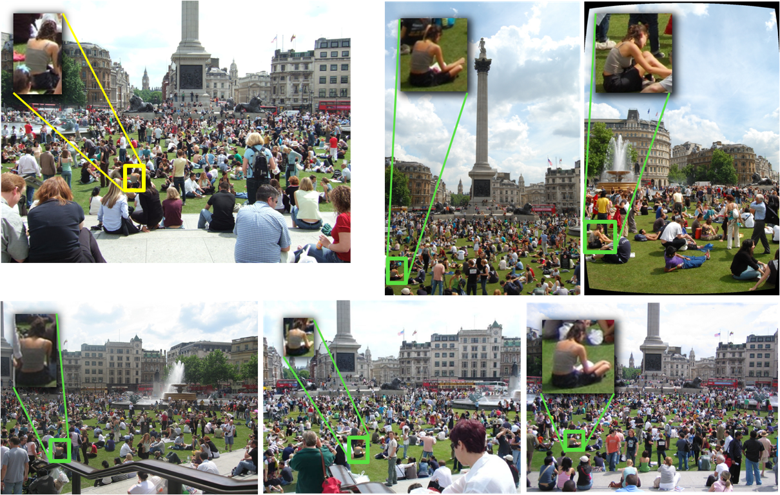
Manually matched photos from a collection of 282
Notes:
It may seem very hard but she does appear in 5 of the 282 photos taken on that day. These matches were found by painfully matching each and every image.

Slide 7
Automatically matched photos from a collection of 282
Notes:
In our work, we come up with an automated method, which when given a single photo given in top left corner, is able to find 4 of the 5 correct matches.

Slide 8
Problems: Severe occlusion, Varying poses and cameras, Low resolution
Detection
and
Recognition
Notes:
This is a very hard detection and recognition problem due to severe occlusion, varying poses and low resolution photos. However,

Slide 9
Problems: Severe occlusion, Varying poses and cameras, Low resolution
Scene Geometry
And
Camera Pose
Part based appearance model
based on cloth color
Detection
and
Recognition
Time stamps: people are
relatively still
over short intervals
Co-occurrence cues: People move
about with
same set of people
Notes:
However, we use variety of cues and combine them together to make the problem tractable. As the number of photo uploads increase, this problem will get more and more interesting and there still a bunch of other cues that one can exploit like GPS tags, social networks, etc.

